Slide 1

Birth defects surveillance training facilitator’s guide, second edition
Module 1: Introduction to Congenital Anomalies Surveillance (Slides 2 – 4)
Module 2: Introduction to Planning Activities and Tools (Slides 5 – 9)
Module 3: Three (Slides 10 – 32)
Source for all illustrations: CDC, NCBDDD
The findings and conclusions in this report are those of the authors and do not necessarily represent the official position of the U.S. Centers for Disease Control and Prevention.

Slide 2
Facilitator’s Guide
Module 1: Introduction to congenital anomalies surveillance

Slide 3
Objectives
By the end of this module, participants will be able to:​
Describe the purpose and importance of public health surveillance for congenital anomalies
Note: Modules 1 – 3 are linked to chapters 1 – 3 of World Health Organization, United States Centers for Disease Control and Prevention and International Clearinghouse for Birth Defects Monitoring Systems. Birth defects surveillance: a manual for programme managers, 2nd edition. World Health Organization; 2015. (https://apps.who.int/iris/handle/10665/337425). License: CC BY-NC-SA 3.0 IGO.

Slide 4

Video
Link: Jay Walker at TEDMED 2010 (9) - Hidden Aspects of Death - YouTube
Notes:
Now we are going to watch a video by Jay Walker, chairman of TEDMED, which shows how the first official compilation of public health data revealed unexpected statistical trends. Display video on screen (https://www.youtube.com/watch?v=5IRsqDnPzSE).

Slide 5
Facilitator’s Guide
Module 2: Introduction to planning activities and tools

Slide 6
Objectives
By the end of this module, participants will be able to:​
identify the basic elements and importance of legislation to support congenital anomalies surveillance;
identify two types of reporting related to congenital anomalies surveillance legislation;
describe voluntary and mandatory reporting, and their advantages and disadvantages;
identify the importance of partnerships to support congenital anomalies surveillance;
identify potential types of partners;
describe the roles partners can play in the surveillance of congenital anomalies;
identify ways to engage partners in surveillance work;
identify the purpose and components of logic models;
understand the benefits of creating a logic model;
develop a logic model;
describe how logic models help guide programme planning and evaluation.

Slide 7
Activity 2.1
Resources | Activities | Outputs | Short- and long-term outcomes | Impact
Need the following resources to accomplish activities: | Need to accomplish the following activities to address the problem: | Once activities are accomplished, expect to have the following product(s) or services: | If activities are accomplished, they will lead to the following changes in 1–3 years: | If activities are accomplished, they will lead to the following changes in 4–6 years:
Staff with the necessary skills Funding Infrastructure Partnerships Leadership support Legislative support Tools for data collection and analysis Identification of existing resources and anticipation of needed resources Identification of champions | Develop surveillance system Identify goals Develop and distribute baseline survey for situational analysis report Identify appropriate stakeholders Select sites Develop and implement surveillance protocol with uniform guidelines Establish pilot for congenital anomalies surveillance Assess data quality and utility Engage partners Create task force Advocate Establish evaluation and monitoring for each step of the programme | Implement surveillance system Produce reports and recommendations Create an upgradeable model surveillance programme Identify risk factors and prevent those congenital anomalies that have modifiable ones | Uniform national implementation of a surveillance programme Enhancement of knowledge Provision of data to develop policies Improvement of necessary infrastructure to manage congenital anomalies | Improved quality of life for affected individuals and their families Reduction in mortality in children aged under 5 years Reduction in preventable congenital anomalies

Slide 8
Activity 2.3
Use the table below to complete a stakeholder’s worksheet for development of a congenital anomalies surveillance programme in your country.
Likely users of outputs | Communication message | Dissemination strategy | Evaluation
Ministries of health
Hospitals and, if relevant, hospital associations and clinics
Champions
Community health workers/community health volunteers
Congenital anomalies associations, foundations and other nongovernmental organizations
International organizations
Medical schools/research agencies
Notes:
Begin Activity 2.3
■ Ask participants to refer to their workbooks, page 4.
■ Have participants complete a stakeholder’s worksheet for development of a congenital anomalies surveillance programme in their country. Tell participants: We are now going to complete a stakeholders’ worksheet. Think of potential roles for each partner and how they will contribute to your surveillance programme.
Note: Before participants begin the activity, the facilitator can choose to complete one row with the participants to show them an example of how it is completed. These are examples, and participants can include other stakeholders appropriate to their needs
■ After they have had time to complete the worksheet, display the completed worksheet (on the following slide) and discuss components with the group.

Slide 9
Sample worksheet: partners/stakeholders
Partners/stakeholders | Potential roles
Ministry of health | Set policies and regulations for health-care services and delivery
Hospitals | Serve as data sources
Community health workers | Serve as potential data sources; help increase awareness of congenital anomalies, risk factors, other
Primary health centres | Data sources; source for prevention and outreach activities
Universities | Opportunity to help increase knowledge
International organizations | Provide advocacy; technical assistance and expertise
Notes:
■ After they have had time to complete the worksheet, display the completed worksheet and discuss components with the group.

Slide 10
Likely users of outputs | Communication message | Dissemination strategy | Evaluation
Ministries of health | Prevalence of congenital anomalies is high Need for continued support for surveillance programme Need for identification of speciality services Need for prevention activities and intervention policies | Report Press conferences | Evaluation of report for clarity of messages Number of places that provide services Effect of prevention policies
Hospitals and, if relevant, hospital associations and clinics | Importance of valid and reliable reporting, and feedback on their performance Number of reports; distribution of reported congenital anomalies by hospital Consistency of reports/data quality | Reports Datasets Newsletters for staff Information given at training sessions, workshops and seminars | Evaluation of report Pre- and post-tests at trainings or workshops
Champions | Importance of their support How they can promote and support implementation of a surveillance programme | Report Letter | Number of champions participating in the programme
Community health workers/community health volunteers | Importance of notification of congenital anomalies seen in the community and with home births, to provide referrals to clinics or ambulatory care centres | Information given at training sessions, workshops and seminars | Pre- and post-tests at training sessions or workshops
Congenital anomalies associations, foundations and other nongovernmental organizations | Need for improved quality of care for individuals living with disabilities | Report Media Educational materials Newsletters | Use of reports Requests for educational material
International organizations | Information about surveillance programme implementation, global impact, how they can support efforts | Report Media, written materials Newsletters | Use of reports Requests for educational material
Medical schools/research agencies | Importance of congenital anomalies mortality and morbidity Importance of congenital anomalies surveillance Prevention of congenital anomalies | Curricula Coursework Seminars | Number of medical schools/agencies integrating the message
Notes:
Script/key points
■ We are now going to discuss the importance of communicating with different types of partners to keep them engaged in the surveillance process. The following table provides ideas for different communication messages and strategies for disseminating these messages to a variety of partner audiences.

Slide 11
Facilitator’s Guide
Module 3: Introduction to surveillance approaches

Slide 12
Objectives
By the end of this module, participants will be able to:
describe population coverage as used in surveillance of congenital anomalies;
describe population-based surveillance;
describe hospital-based surveillance;
compare and contrast population-based surveillance and hospital-based surveillance;
describe the three types of case ascertainment;
describe the advantages and disadvantages of active and passive case ascertainment;
describe case-finding in congenital anomalies surveillance;
identify the differences between a single data source and multiple data sources;
describe considerations for inclusion criteria used in the surveillance of congenital anomalies;
identify the congenital anomalies to include in the programme;
describe considerations for inclusion of particular congenital anomalies;
describe how data can be used for decision-making;
identify considerations for communicating and disseminating surveillance data;

Slide 13
Objectives continued…
By the end of this module, participants will be able to:​
identify different communication methods;
identify variables that will reflect the objectives of the programme;
describe core variables;
describe additional variables;
identify sources to collect variables;
understand the elements of quality and value in congenital anomalies surveillance;
recognize the importance of shared procedures and protocols;
identify selected processes and data elements that can be tracked for ongoing quality improvement;
understand the meaning of birth prevalence;
compute birth prevalence; and
comment on data that are similar to those presented in the exercises.

Slide 14
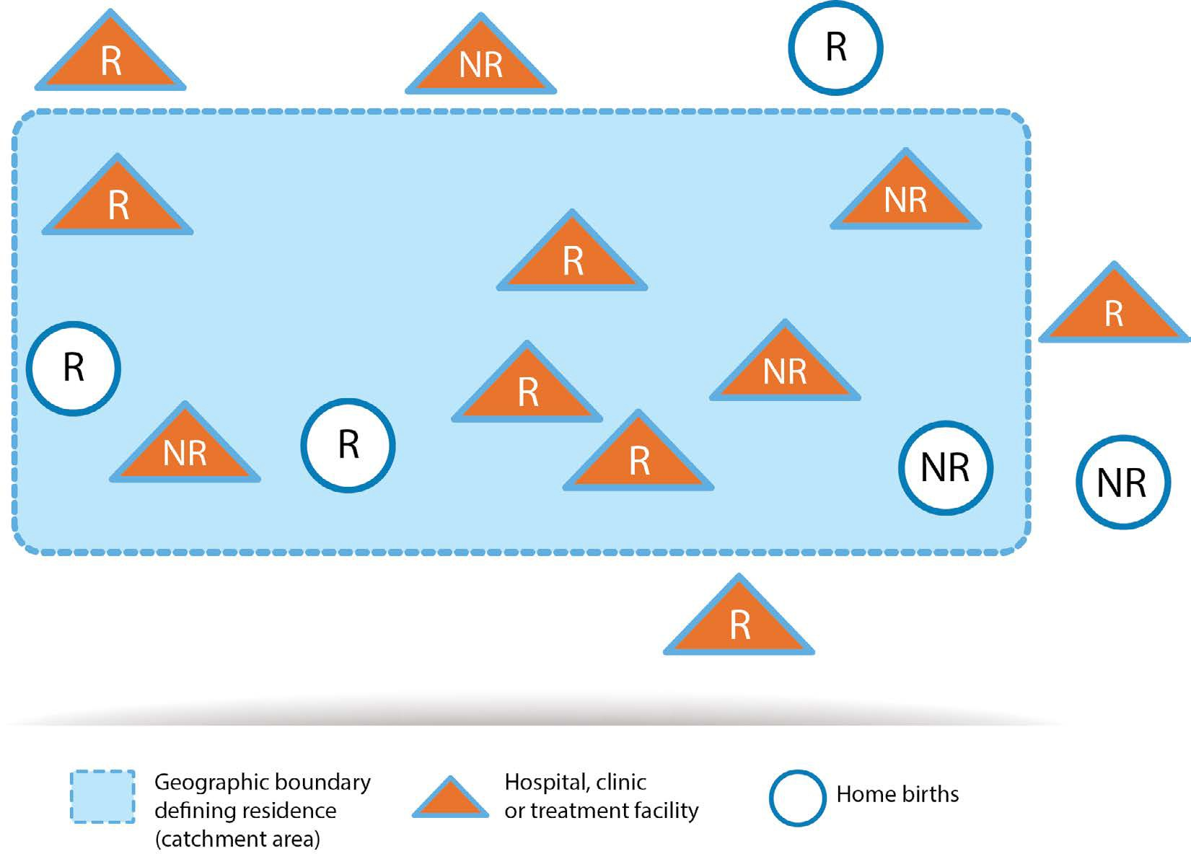
Activity 3.1
Study the figure below.
R = fetus or neonate with congenital anomaly whose mother is a resident.
NR = fetus or neonate with congenital anomaly whose mother is a non-resident.
Q: Does the figure represent a population-based or hospital-based surveillance programme?
Q: What is the numerator (cases that should be registered) in this surveillance programme?
Q: Is maternal residence important for this type of surveillance?
Q: Are home births with congenital anomalies counted in this type of surveillance?
Notes:
Begin Activity 3.1
Ask participants to refer to their workbooks, page 5, and ask them to complete the following activity.
Show illustration (A) to the group without the numbers and the answers.
Ask participants to complete the following questions (included in their workbooks, page 5). Allow 10 minutes and then discuss the responses as a group. (Responses are in italic)
Question: Does this figure represent a population-based or hospital-based surveillance programme?
Answer: The figure represents a population-based programme.
Question: What is the numerator (cases that should be registered) in this surveillance programme?
Answer: 10 cases in total. All fetuses or newborns identified with a birth defect born to mothers residing within the catchment area (dashed area) are included in the program (#2 to #7 in the figure). Similarly, a fetus or newborn with a birth defect who is born outside of the defined catchment area (including one who is born at home while the mother is visiting a family member living outside of the catchment area, for example) would still be included if the mother is herself a resident of the catchment area (#1, #8, #9, and #10 in the figure). Fetuses or newborns identified with a birth defect and born to non‐resident mothers are not included (#11–16 in the figure) even though they are born in hospitals within the catchment area.
Question: Is maternal residence important for this type of surveillance?
Answer: Yes it is; all neonates with congenital anomalies should be included if the mother is a resident.
Question: Are home births with congenital anomalies counted in this type of surveillance?
Answer: Yes, if the mother is a resident. No, if the mother is not a resident.

Slide 15
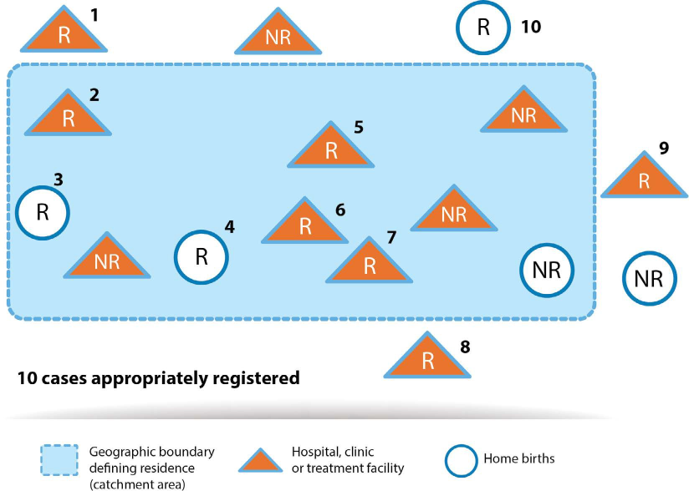
R = fetus or neonate with congenital anomaly whose mother is a resident.
NR = fetus or neonate with congenital anomaly whose mother is a non-resident.
Notes:
(Responses are in italic)
Question 1: Does this figure represent a population-based or hospital-based surveillance programme?
Answer: The figure represents a population-based programme.
Question 2: What is the numerator (cases that should be registered) in this surveillance programme?
Answer: 10 cases in total. All fetuses or newborns identified with a birth defect born to mothers residing within the catchment area (dashed area) are included in the program (#2 to #7 in the figure). Similarly, a fetus or newborn with a birth defect who is born outside of the defined catchment area (including one who is born at home while the mother is visiting a family member living outside of the catchment area, for example) would still be included if the mother is herself a resident of the catchment area (#1, #8, #9, and #10 in the figure). Fetuses or newborns identified with a birth defect and born to non‐resident mothers are not included (#11–16 in the figure) even though they are born in hospitals within the catchment area.
Question 3: Is maternal residence important for this type of surveillance?
Answer: Yes it is; all neonates with congenital anomalies should be included if the mother is a resident.
Question 4: Are home births with congenital anomalies counted in this type of surveillance?
Answer: Yes, if the mother is a resident. No, if the mother is not a resident.

Slide 16
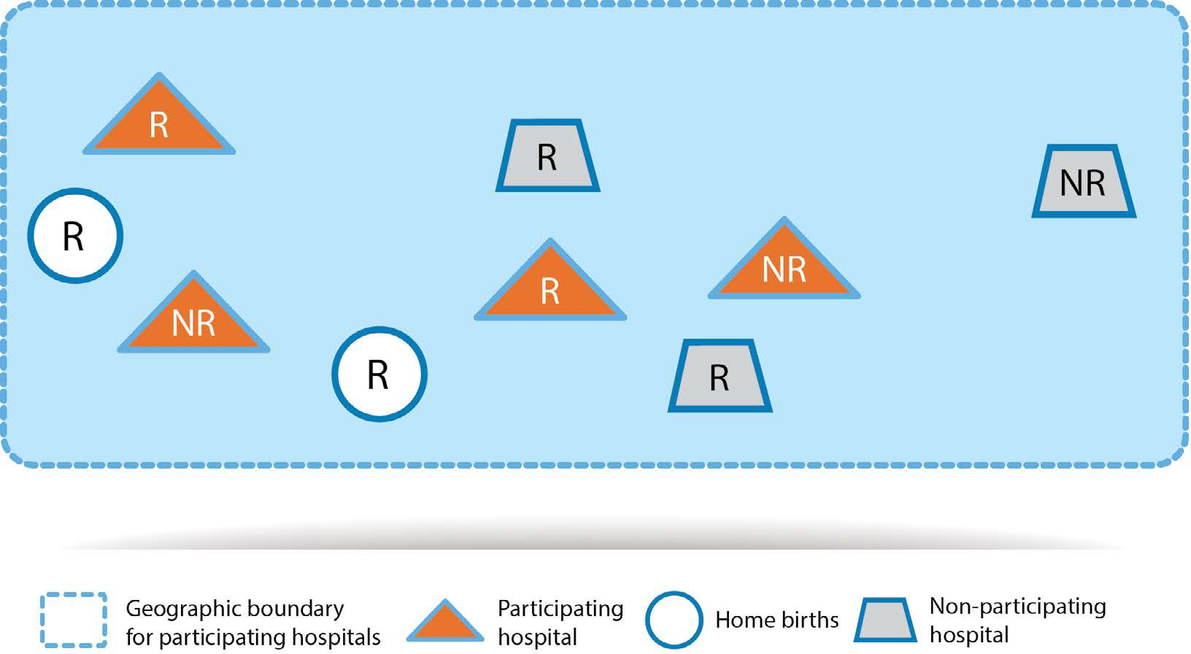
Activity 3.1 continued
Study the figure below.
R = fetus/neonate with a birth defect whose mother is a resident .
NR = fetus/neonate with a birth defect whose mother is a non-resident.
Q: Does the figure represent a population-based or hospital-based surveillance programme?
Q: What is the numerator (cases that should be registered) in this surveillance programme?
Q: Is maternal residence important for this type of surveillance?
Q: Are home births with congenital anomalies counted in this type of surveillance?
Notes:
Activity 3.1 continued
Show illustration (B) without the numbers and the answers to the group and ask them to complete the corresponding questions, tell them that the illustration and questions are in their workbooks, page 6.
Ask participants to complete the following questions (included in their workbooks, page 5). Allow 10 minutes and then discuss the responses as a group. (Responses are in italic)
Question: Does this figure represent a population-based or hospital-based surveillance programme?
Answer: The figure represents a hospital-based programme.
Question: What is the numerator (cases that should be registered) in this surveillance programme?
Answer: 4; births that occur in the four participating hospitals shown in the figure.
Question 3: Is maternal residence important for this type of surveillance?
Answer: No, it is not; neonates with congenital anomalies at participating hospitals should be included regardless of the mother’s residency.
Question: Are home births with congenital anomalies counted in this type of surveillance?
Answer: No, they are not included; only births that occur in participating hospitals should be included.

Slide 17
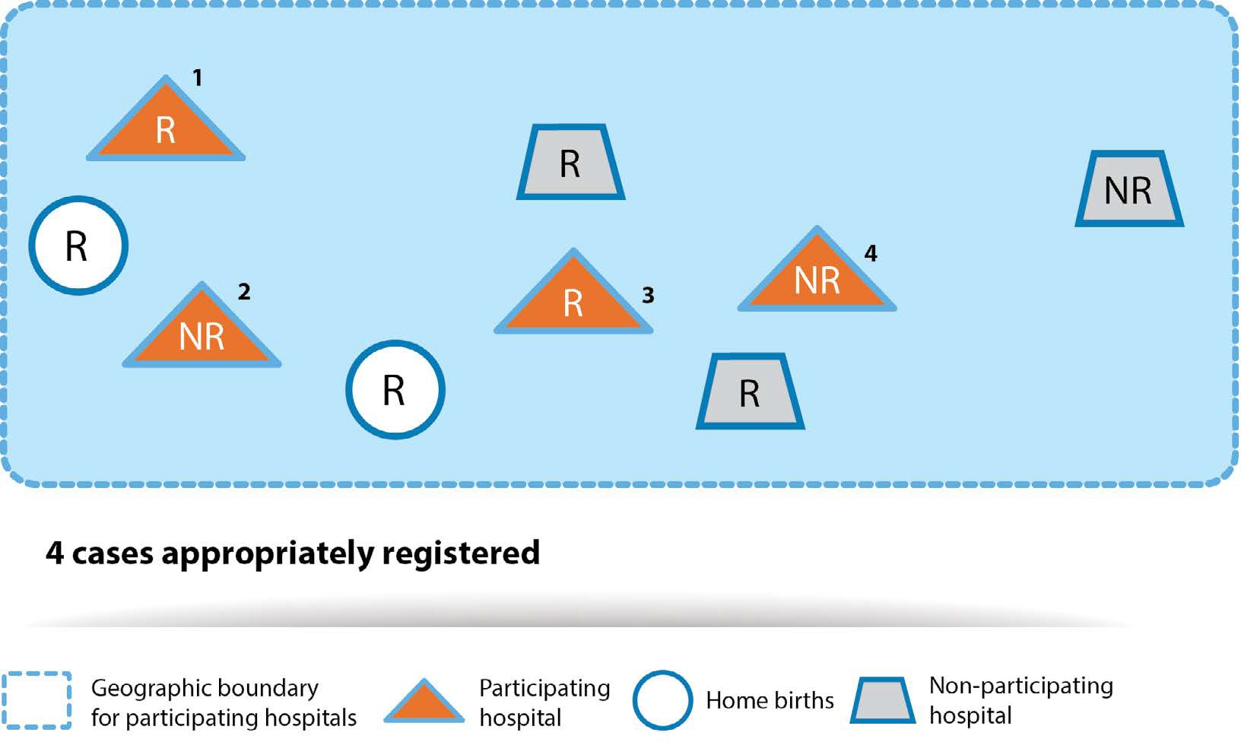
R = fetus or neonate with congenital anomaly whose mother is a resident.
NR = fetus or neonate with congenital anomaly whose mother is a non-resident.
Notes:
(Responses are in italic)
Question: Does this figure represent a population-based or hospital-based surveillance programme?
Answer: The figure represents a hospital-based programme.
Question: What is the numerator (cases that should be registered) in this surveillance programme?
Answer: 4; births that occur in the four participating hospitals shown in the figure.
Question 3: Is maternal residence important for this type of surveillance?
Answer: No, it is not; neonates with congenital anomalies at participating hospitals should be included regardless of the mother’s residency.
Question: Are home births with congenital anomalies counted in this type of surveillance?
Answer: No, they are not included; only births that occur in participating hospitals should be included.

Slide 18
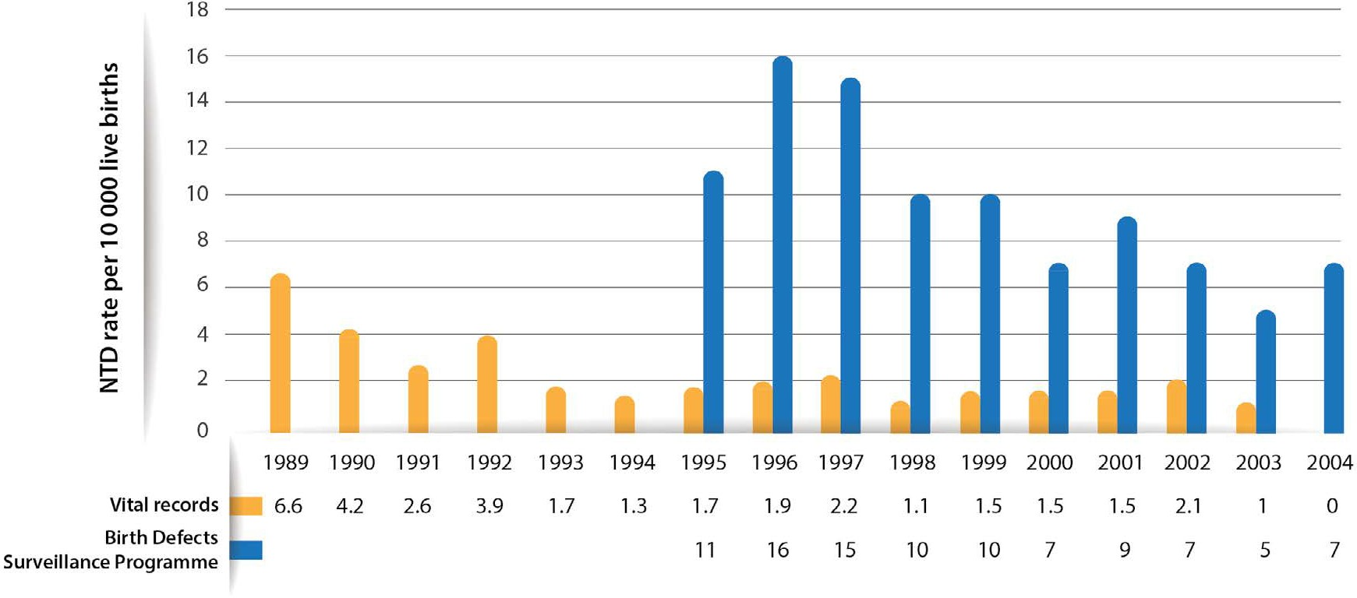
Activity 3.2
Prevalence of neural tube defects by source
NTD: neural tube defects.
Source: Birth Defects Surveillance Programme Puerto Rico Department of Health, and Auxiliary Secretariat for Planning and Development, San Juan, Puerto Rico.
Q: What does this figure demonstrate?
Notes:
Begin Activity 3.2
Show participants the figure. Ask participants to refer to their workbook, page 7, and answer the following question: What does this figure demonstrate?
Allow participants time to write responses. Encourage group discussion about responses before reviewing.
Possible responses:
This example demonstrates how using multiple data sources increased the case detection compared to only using vital records.
It shows 16 years of vital records data and 10 years of data from multiple sources.
The data are for neural tube defects.
The birth prevalence of neural tube defects has changed over time.
Multiple sources identify more cases with neural tube defects.
Vital records usually include data at birth and multiple sources may include other age cut-off values that allow for identification of cases later in life.

Slide 19
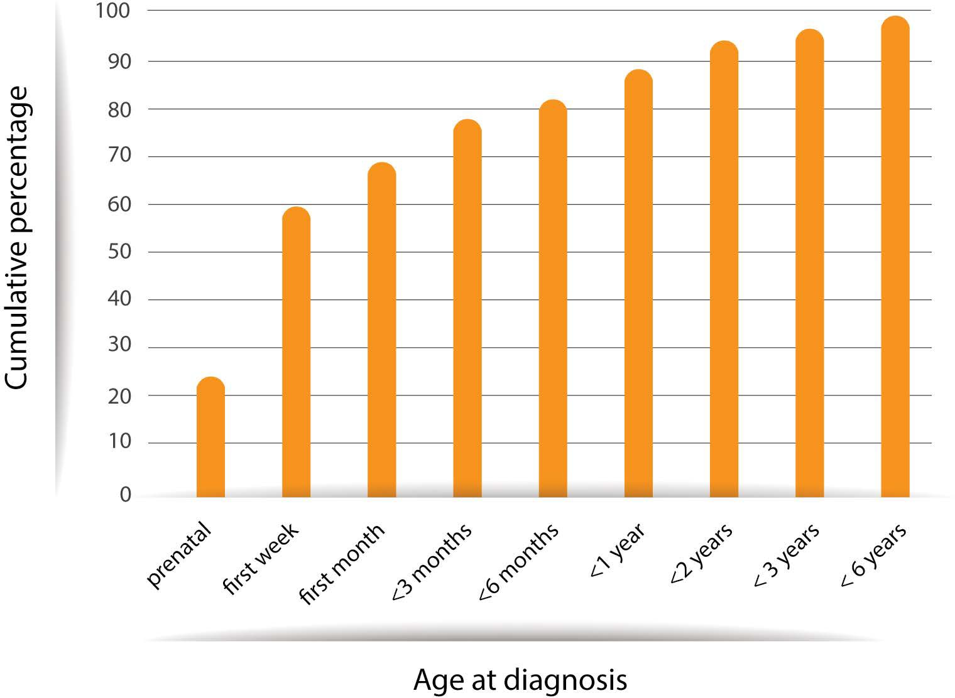
Activity 3.2 group discussion
Cumulative percentage of cases of major congenital anomalies by age at first diagnosis
Source: Bower C, Rudy E, Callaghan A, Quick J and Nassar N. Age at diagnosis of birth defects. Birth Defects Res A Clin Mol Teratol. 2010;88: 251–255 (https://doi.org/10.1002/bdra.20658).
Notes:
Tell participants: Please look at the following graph, showing an example of how age at diagnosis has been used. Researchers examined the age at diagnosis for all congenital anomalies reported to the Western Australian Birth Defects Registry from 2000 to 2001.
Begin Group discussion
Show participants the figure, which represents how researchers examined the age at diagnosis for all congenital anomalies reported to the Western Australia Birth Defects Registry from 2000 to 2001.

Slide 20
Activity 3.3
Create inclusion and exclusion criteria for population-based or hospital-based surveillance programmes.
Notes:
Begin Activity 3.3
Ask participants to refer to Activity 3.3 in their workbooks.
Have participants create inclusion and exclusion criteria for population-based or hospital-based surveillance programmes. Ask participants to keep in mind capacity and available data sources. Remind them that the inclusion and exclusion criteria will be different, depending on whether the programme is hospital-based or population-based. Allow 10 minutes and then discuss the responses as a group.
Possible responses:
Inclusion criteria:
Born with one of the congenital anomalies under surveillance
Age at diagnosis (up to 1 year of age)
Pregnancy outcome (live births, stillbirths and termination of pregnancies for fetal anomaly)
Gestational age (≥28 weeks, or ≥1000 g; ≥20–22 weeks of gestation or ≥500)
Maternal residence (born to resident mother)
Hospital of delivery (born in selected hospitals)
Exclusion criteria:
Born without a congenital anomaly under surveillance
Older than 1 year of age
Miscarriage/spontaneous abortion
Less than 28 weeks of gestation, or <1000 g
Born in non-selected hospitals
Born to non-resident mother

Slide 21
Possible Responses:
Inclusion Criteria | Exclusion Criteria
Born with one of the congenital anomalies under surveillance Age at diagnosis (up to 1 year of age) Pregnancy outcome (live births, stillbirths and termination of pregnancies for fetal anomaly) Gestational age (≥28 weeks, or ≥1000 g; ≥20–22 weeks of gestation or ≥500) Maternal residence (born to resident mother) Hospital of delivery (born in selected hospitals) | Born without a congenital anomaly under surveillance Older than 1 year of age Miscarriage/spontaneous abortion Less than 28 weeks of gestation, or <1000 g Born in non-selected hospitals Born to non-resident mother
Notes:
Begin Activity 3.3
Ask participants to refer to Activity 3.3 in their workbooks.
Have participants create inclusion and exclusion criteria for population-based or hospital-based surveillance programmes. Ask participants to keep in mind capacity and available data sources. Remind them that the inclusion and exclusion criteria will be different, depending on whether the programme is hospital based or population based. Allow 10 minutes and then discuss the responses as a group.
Possible responses:
Inclusion criteria:
Born with one of the congenital anomalies under surveillance
Age at diagnosis (up to 1 year of age)
Pregnancy outcome (live births, stillbirths and termination of pregnancies for fetal anomaly)
Gestational age (≥28 weeks, or ≥1000 g; ≥20–22 weeks of gestation or ≥500)
Maternal residence (born to resident mother)
Hospital of delivery (born in selected hospitals)
Exclusion criteria:
Born without a congenital anomaly under surveillance
Older than 1 year of age
Miscarriage/spontaneous abortion
Less than 28 weeks of gestation, or <1000 g
Born in non-selected hospitals
Born to non-resident mother

Slide 22
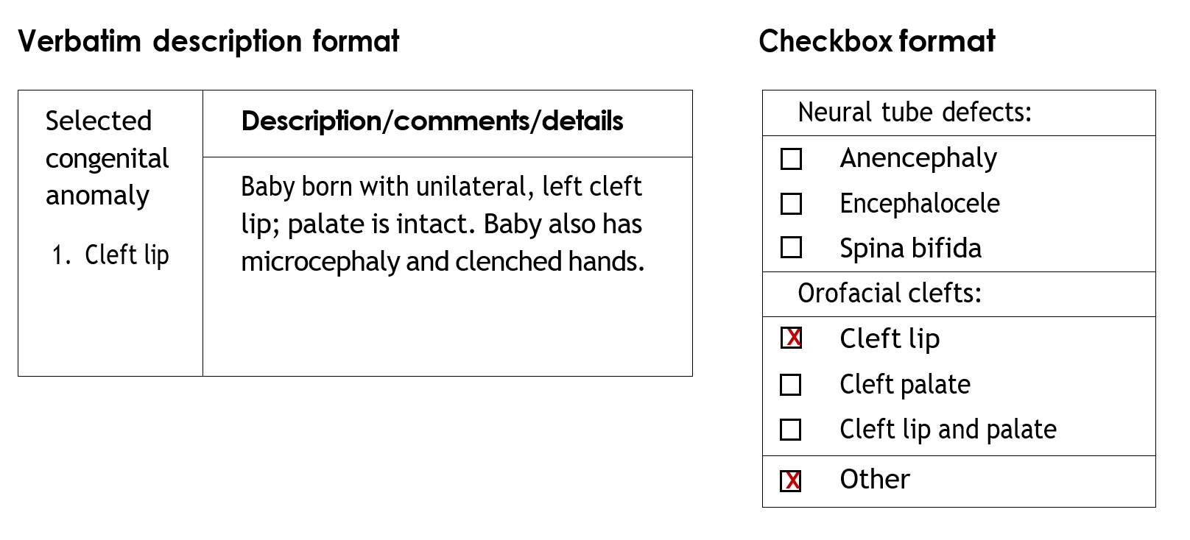
Activity 3.5
Review the formats below.
Q: What do these examples demonstrate?
Notes:
Begin Activity 3.5
Show the participants the examples of verbatim and checkbox formats.
Ask participants the following question: What do these examples demonstrate?
Ask participants to refer to Activity 3.5 in their workbook to record their responses.
Encourage group discussion about responses before reviewing.
Possible responses:
These examples demonstrate how using verbatim descriptions can add more thorough information about a diagnosis.
Using only the checkbox format requires a programme to rely solely on the training and expertise of the member of staff who checked the box, to complete the form.
A checkbox format might facilitate coding and data management; however, detailed information that would help with a diagnosis may be missed.

Slide 23
Activity 3.6
Review the table below and consider the suggested core ascertainment variables.
Category | Variable name | Why this variable should be collected
Report | Case record identification
 | City, province, state or territory
Father | Name(s)
Mother | Name(s)
 | Mother’s date of birth, or age if date of birth is not available
 | Total number of pregnancies
Infant | Date of birth
 | Sex
 | Outcome at birth
Notes:
Begin Activity 3.6
Ask participants to refer to Activity 3.6 in their workbook.
Review the table and discuss the suggested core ascertainment variables. Discuss how variables might differ, depending on the participant’s country, and how they would be adapted. Direct participants to Appendices H and I in Birth defects surveillance: a manual for programme managers (MPM2) for additional variables to consider.
Ask participants to write in the blank column in their workbook the reason a variable presented in the table should be collected. Once they have completed the table, show participants the following table (on the next slide) with possible responses for further discussion.

Slide 24
Category | Variable name | Why this variable should be collected (responses in italics below)
Report | Case record identification | To retrieve a form, and ensure that it is not duplicated in the database
 | City, province, state, or territory | To identify the prevalence of congenital anomalies by place of birth
Father | Name(s) | To retrieve information, link infant
Mother | Name(s) | To retrieve information, link infant
 | Mother's date of birth, or age if date of birth is not available | To identify the distribution and prevalence of congenital anomalies by maternal age (maternal age is a risk factor for some congenital anomalies)
 | Total number of pregnancies | To identify the distribution and prevalence of congenital anomalies by previous parity
Infant | Date of birth | To retrieve information, and to ascertain the distribution of congenital anomalies by month/year
 | Sex | To identify the distribution of congenital anomalies by sex
 | Outcome at birth | To identify the distribution and prevalence of congenital anomalies by pregnancy outcome. Prevalence can be calculated by live births with or without stillbirths and elective terminations of pregnancy with fetal anomalies (ETOPFA)
Notes:
Once participants have completed their tables, show participants this table with possible responses for further discussion.
Each country can develop a fictitious record(s) based on the typical variables collected in the country, and participants can be asked to abstract the information into the data-collection tool (see Activity 3.4). For the activity, the facilitator can look at different charts from the hospitals, to create beforehand a “record” that can be used.

Slide 25
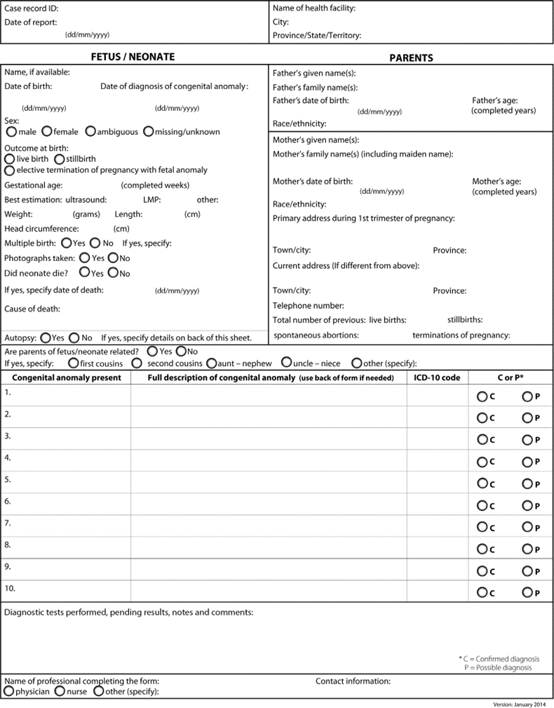
Activity 3.7
Birth defects surveillance programme
Review the form below, and consider which variables you would add or delete, and why.
Notes:
Begin Activity 3.7
Ask participants to refer to Activity 3.7 in their workbooks.
Show the example of an abstraction form. Ask participants to consider the form, based on how they plan to collect data (paper-based or electronic collection) and which variables they would add or delete, and why.

Slide 26
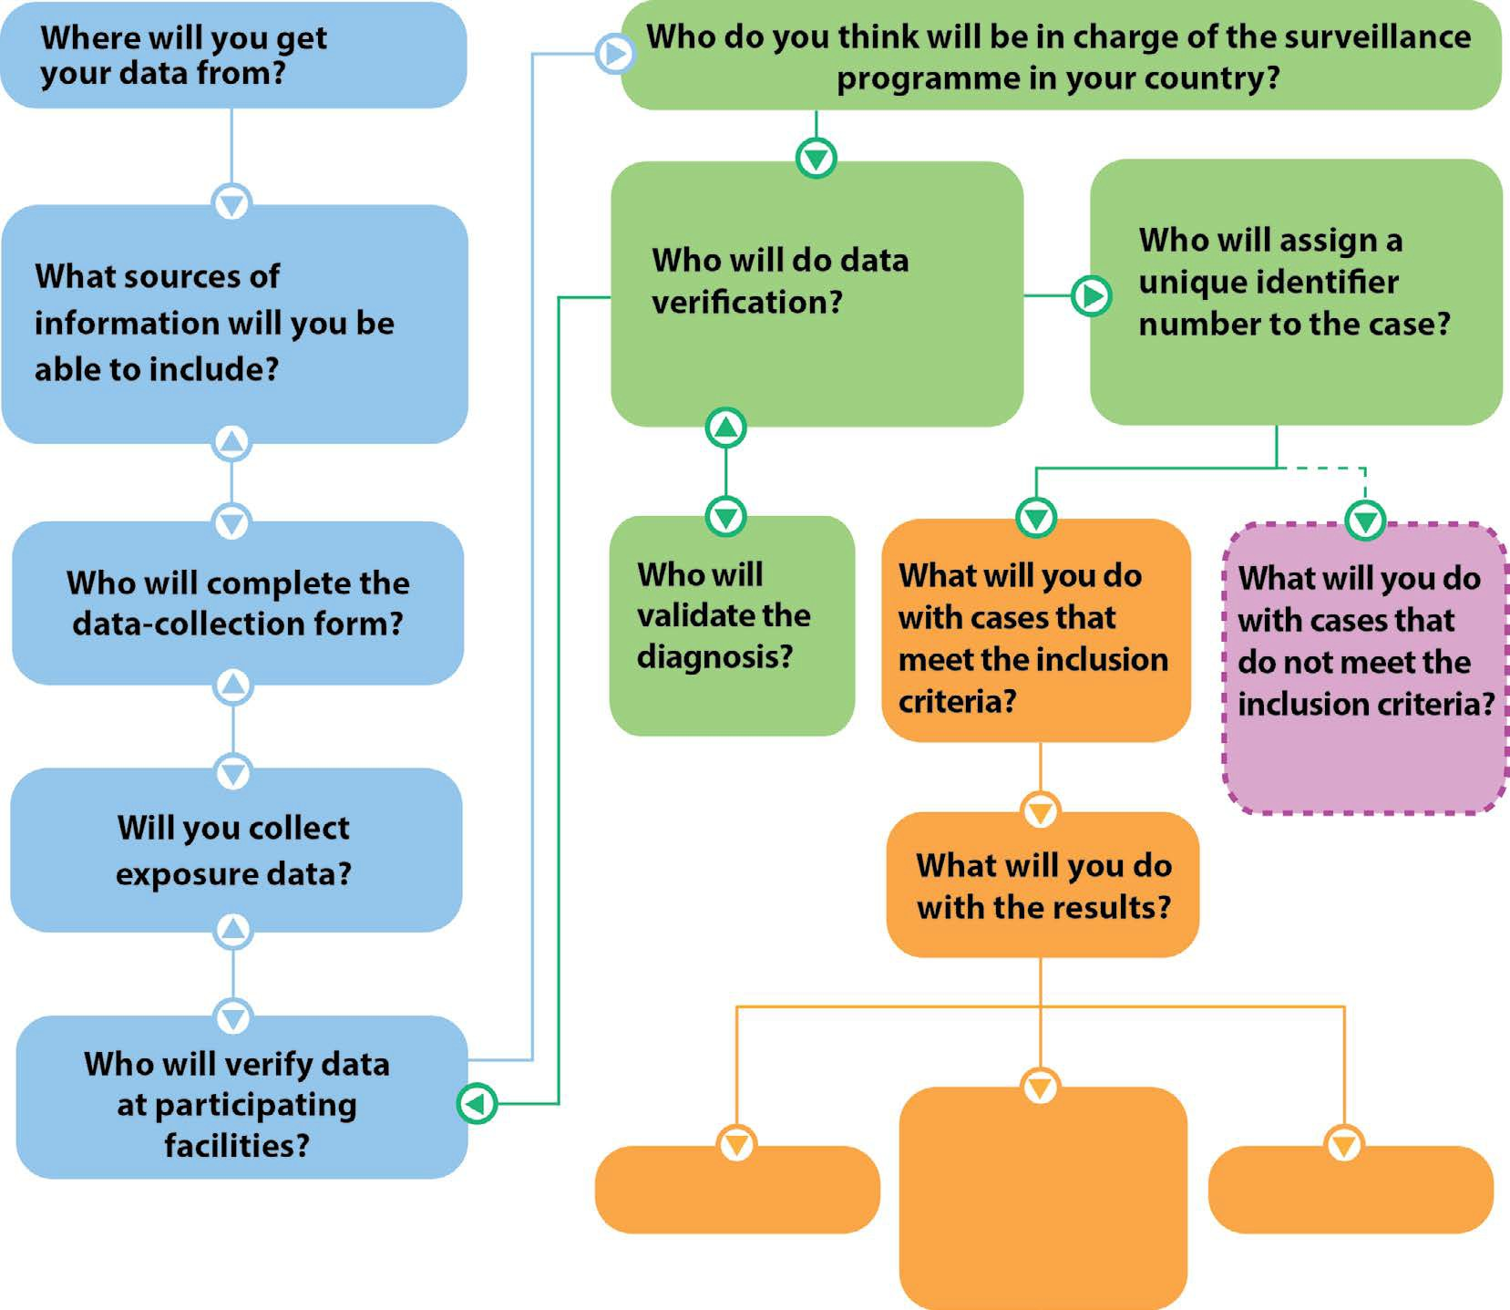
Activity 3.8
Complete the flow chart.
Notes:
Begin Activity 3.8
Ask participants to refer to Activity 3.8 in their workbook. Review the questions in the flow chart and provide responses to them.
Ask participants to complete the flow chart.
After participants complete their flow chart, show the following chart (on the next slide) with possible responses and discuss participants’ responses.

Slide 27
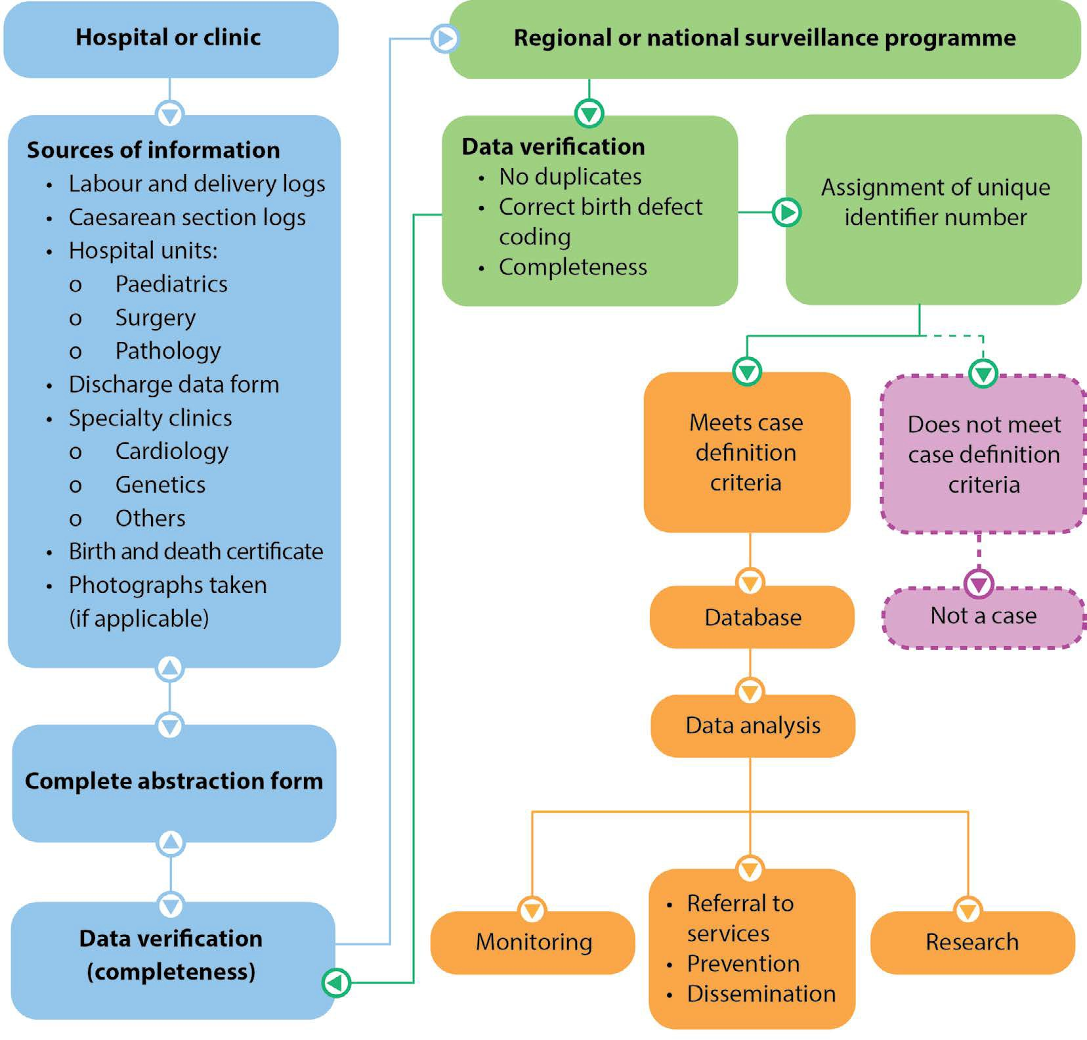
Possible response:
Notes:
Possible response shown here.
The protocol for data collection and management should include procedures for:
identification of data sources where congenital anomalies can be identified
identification and registration of congenital anomalies by health-care professionals in each data source
training of personnel responsible for coding congenital anomalies according to the ICD-10 coding system
taking photographs of a fetus or neonate with congenital anomalies, if appropriate for the setting
verifying the information at the participating hospital site
sending information to a regional or national-level surveillance programme.
It is important that the data collection and analysis are done in a systematic way by trained personnel, to ensure high-quality data and accurate interpretation.
Poor-quality data can lead to false conclusions about the occurrence of a congenital anomaly in a population, and weaken the credibility of the programme.
Inaccurate interpretation could have a substantial impact on the decision-making process of public health authorities.

Slide 28
Birth prevalence
Birth prevalence = a/b × 10 000
Notes:
Script/key points
Let’s now talk about the typical measures used in surveillance of congenital anomalies; these measures include birth prevalence and trends.
Ask participants: Does anyone know how to estimate birth prevalence? Open for discussion, and then display the prevalence formula on screen. Discuss the difference between total prevalence, birth prevalence and live birth prevalence among participants (additional information can be found in Chapter 3 of the MPM2).
In a population-based surveillance programme, the total prevalence of congenital anomalies is calculated by aggregating the number of unduplicated cases (live births, stillbirths and ETOPFA) as the numerator, and the total number of live births and stillbirths in the source population as the denominator, for a specific catchment area and time period.
In hospital-based surveillance, the total prevalence of congenital anomalies is calculated by aggregating the number of unduplicated hospital cases (live births, stillbirths and ETOPFA) as the numerator, and the total number of live births and stillbirths from a participating hospital as the denominator, for a specific time period.
The prevalence of congenital anomalies is usually calculated and presented as prevalence per 10 000 births. Prevalence can be calculated for all congenital anomalies, specific individual congenital anomalies, or groups of anomalies.
Prevalence cannot be calculated with only the number of cases – the numerator data – without having information about the denominator.
The following expression is used to calculate the birth prevalence of congenital anomalies, with the assumption that both live births and fetal deaths are being captured:
Birth prevalence = a/b × 10 000
a = Number of live births and fetal deaths (stillbirths) with a specific congenital anomaly (e.g., spina bifida) counted among the source population in a given year
b = Number of live births and fetal deaths (stillbirths) (includes cases in ‘a’), during the same year
Live birth prevalence of congenital anomalies
live birth cases
=
total live births
x 10 000
Birth prevalence of congenital anomalies =
live birth cases + fetal death (stillbirths) cases total live births + fetal deaths (stillbirths)
x 10 000
Total prevalence of congenital anomalies =
live birth cases + fetal death (stillbirths) cases + ETOPFA cases total live births + total fetal deaths (stillbirths) + ETOPFA
x 10 000
ETOPFA = elective termination of pregnancy for fetal anomaly.
The numerator includes live births and known fetal deaths (stillbirths) with congenital anomalies, and pregnancy terminations with congenital anomalies (if these data are available). The denominator comprises only live births and fetal deaths (stillbirths, if these data are available), because it is practically impossible to assess the total number of pregnancy losses. Because the number of pregnancy losses is relatively small, compared with the number of live births, their exclusion has little effect on the prevalence estimate. Spontaneous abortions (also called miscarriages) are not included in the numerator or in the denominator because it is practically impossible to assess the total number of spontaneous abortions.

Slide 29
Activity 3.9
Prevalence of neural tube defects by type of ascertainment, USA, 2010–2014
Neural tube defects | Active ascertainmentª | Hybrid ascertainment^{b} | Passive ascertainment^{c} | National
Anencephaly | 1306 | 379 | 466 | 2151
Spina bifida | 2082 | 1293 | 1241 | 4616
Encephalocele | 559 | 326 | 285 | 1170
Total neural tube defects | 3947 | 1998 | 1992 | 7937
a N=16 programmes; number of live births = 5 502 807
b N=10 programmes; number of live births = 4 792 252
c N=13 programmes; number of live births= 3 528 713
Source: Mai CT, Isenburg JL, Canfield MA, et al. National population-based estimates for major birth defects, 2010–2014. Birth Defects Res. 2019;1–16. (https://doi.org/10.1002/bdr2.1589).
Q: Estimate the national prevalence for each neural tube defect and for the total neural tube defects per 10 000 live births.
Q: Estimate the birth prevalence for each neural tube defect per 10 000 live births by type of ascertainment.
Q: Estimate the birth prevalence for total neural tube defects per 10 000 live births by ascertainment.
Notes:
Begin Activity 3.9
Divide participants into groups. Ask participants to read the following case example and to calculate the prevalence of neural tube defects. Tell them that they have the information in their workbook.
Case-study 1: Cases of neural tube defects by type of ascertainment, United States of America (USA), 2010–2014
The United States National Birth Defects Prevention Network collects state-specific congenital anomalies surveillance data for annual publication of prevalence estimates and collaborative research projects. In 2019, national estimates were presented for 29 major birth defects using data from 2010–2014. The data presented in the table are from population-based programmes that have different types of case ascertainment: active, hybrid and passive. Active ascertainment occurs when there is active review of multiple data sources to identify cases. Active ascertainment usually requires that the programme hires trained personnel to conduct abstraction from data sources. Passive ascertainment occurs when hospital staff report cases directly to the programme without verification of cases by the programme staff. An example of hybrid ascertainment is when hospital staff report cases and programme staff verify them.
Ask participants to answer the questions in their workbook:
Estimate the national prevalence for each neural tube defect and for the total neural tube defects per 10 000 live births.
Estimate the birth prevalence for each neural tube defect per 10 000 live births by type of ascertainment.
Estimate the birth prevalence for total neural tube defects per 10 000 live births by ascertainment.

Slide 30
Prevalence of neural tube defects by type of ascertainment, USA, 2010–2014
 | Active ascertainmentª |  | Hybrid ascertainment^{b} |  | Passive ascertainment ^{c} |  | National
Neural tube defects | Cases | Prevalence | Cases | Prevalence | Cases | Prevalence | Cases | Prevalence
Anencephaly | 1306 | 2.37 | 379 | 0.79 | 466 | 1.32 | 2151 | 1.56
Spina bifida | 2082 | 3.78 | 1293 | 2.70 | 1241 | 3.52 | 4616 | 3.34
Encephalocele | 559 | 1.02 | 326 | 0.68 | 285 | 0.81 | 1170 | 0.85
Total neural tube defects | 3947 | 7.17 | 1998 | 4.17 | 1992 | 5.65 | 7937 | 5.74
a N=16; number of live births = 5 502 807
b N=10; number of live births = 4 792 252
c N=13; number of live births = 3 528 713
Source: Mai CT, Isenburg JL, Canfield MA, et al. National population-based estimates for major birth defects, 2010–2014. Birth Defects Res. 2019;1–16. (https://doi.org/10.1002/bdr2.1589).
Notes:
After enough time has been given. Show the answers presented on this slide.
Ask participants: Describe the differences and similarities in prevalence by ascertainment method, and provide some reasons for why differences might exist.
Possible responses:
The prevalence of specific defects varied by ascertainment method.
The prevalence of anencephaly varied considerably by ascertainment method.
Possible reasons for differences include:
Some programmes may include elective terminations.
Some programmes may include stillbirths in the numerator, denominator or both.
Some programmes may have conducted specialized prenatal ascertainment.
The prevalence of encephalocele was higher among the passive ascertainment method than among the hybrid or active ascertainment methods.
Ask participants: What are some possible reasons why the three ascertainment methods have different prevalence estimates for spina bifida?
Possible responses:
misclassification of cases at birth;
reporting problems/congenital anomalies not reported – could say biased reporting, i.e., underreporting, overreporting or selective reporting;
hybrid ascertainment methods are able to assess probable cases during follow-up and provide a definitive diagnosis.

Slide 31
Activity 3.10
Prevalence of neural tube defects in the USA per 10 000 live births by race/ethnicity (1995–2011)
 | Year
Race/ ethnicity | 1995 | 1996 | 1997 | 1998 | 1999 | 2000 | 2001 | 2002 | 2003 | 2004 | 2005 | 2006 | 2007 | 2008 | 2009 | 2010 | 2011
Caucasian | 7.1 | 7.8 | 6.6 | 5.5 | 5.4 | 5.3 | 5.1 | 4.5 | 4.6 | 5.1 | 4.6 | 4.9 | 5.3 | 4.4 | 5.2 | 4.7 | 4.8
Black | 4.9 | 5.8 | 3.6 | 4.8 | 4.8 | 4.5 | 4.8 | 5.2 | 4.2 | 3.7 | 3.9 | 3.4 | 3.8 | 4.8 | 4.1 | 3.5 | 3.7
Hispanic | 9.2 | 10.8 | 9.6 | 7.4 | 7.8 | 6.4 | 6.6 | 6.9 | 6.8 | 6.5 | 6.2 | 5.7 | 6.0 | 6.4 | 6.9 | 7.1 | 6.5
Source: Williams J, Mai CT, Mulinare J, et al. Updated estimates of neural tube defects prevented by mandatory folic acid fortification — United States, 1995–2011. MMWR Morb Mortal Wkly Rep. 2015;64:1–5. (https://www.cdc.gov/mmwr/preview/mmwrhtml/mm6401a2.htm).
  Q: Has folic acid fortification of staple foods impacted the prevalence of neural tube defects?
  Q: If so, how has it impacted the prevalence of neural tube defects?
Notes:
Begin Activity 3.10
Divide participants into groups of three or four participants. Ask participants to read the scenario below. Ask participants to go to Activity 3.10 of their workbook.
Case example 2: Pre- and post-fortification birth prevalence of neural tube defects in the USA, 1999–2007
In 1996, folic acid fortification of cereal grain products labelled as enriched became voluntary in the USA. In 1998, a mandate was passed requiring that these products be fortified with folic acid, to ensure an adequate supply of folate for women of childbearing age.
The United States National Birth Defects Prevention Network collects information on neural tube defects by three major race/ethnic groups and has data from the time period prior to mandatory folic acid fortification and following the folic acid fortification mandate. The estimated annual prevalence of neural tube defects for 19 population-based birth defects surveillance programmes in the USA during these time periods is presented in the table below.
Ask participants:
Has folic acid fortification of staple foods impacted the prevalence of neural tube defects?
If so, how has it impacted the prevalence of neural tube defects?
Possible response:
Folic acid fortification of staple foods is most likely responsible for the majority of the decline in prevalence of neural tube defects. The observable decline in the prevalence of neural tube defects is probably due to fortification.
Note: If participants have a computer and access to Excel or another spreadsheet program, ask them to make a graph with the data provided.
Remind participants about the:
need for a meaningful scale on the Y axis, to improve understanding and the use of a timescale on the X axis to show trends;
importance of axis labelling;
use of highlighting effects or factors of interest, such as year in which fortification started in the USA (voluntary and mandatory); and
need for clear and descriptive titles.
Public health agencies have a long tradition of monitoring trends in rates of disease and death, and in medical, social and behavioural risk factors that may contribute to these adverse events. Trends in observed rates provide information for needs assessment, programme planning, programme evaluation, and policy development activities. Examining data over time also allows predictions to be made about future frequencies and rates of occurrence.
Typically in public health, trend data are presented as population-based rates. These data are accessed from large database systems such as national vital records, and show how rates change over relatively long periods of time, e.g. 10 years or more. Trend data can be visually presented through tables and graphs. The figure in the next slide shows secular trend data for the prevalence of neural tube defects in the USA by race/ethnicity.

Slide 32
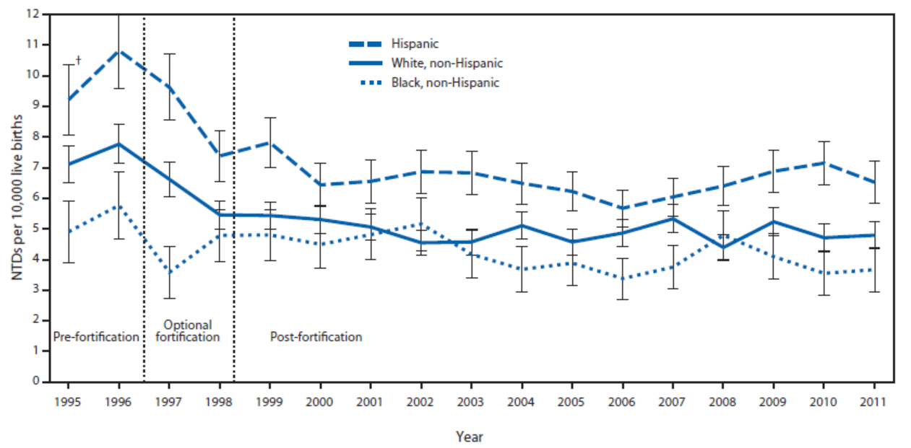
Describe the prevalence of neural tube defects and the secular (long-term) trend using the graph below.
Prevalence of neural tube defects (per 10 000 births) by maternal race/ethnicity, USA, 1995–2011
Source: Williams J, Mai CT, Mulinare J, et al. Updated estimates of neural tube defects prevented by mandatory folic acid fortification — United States, 1995–2011. MMWR Morb Mortal Wkly Rep. 2015;64:1–5. (https://www.cdc.gov/mmwr/preview/mmwrhtml/mm6401a2.htm).
  Q: When was change first evident?
  Q: What are some possible reasons for some of the changes observed in the prevalence of neural tube defects?
  Q: What are some factors that could impact the prevalence of a health condition?
Notes:
Ask participants: Describe the prevalence of neural tube defects and the secular (long-term) trend. Is there a change in the prevalence of neural tube defects? What is the direction of the change?
Possible response: There is a decline in the prevalence of neural tube defects.
Ask participants:
When was this change first evident?
Possible response: The change in prevalence started in the year 1997. After that point, the decrease in prevalence of neural tube defects accelerated through 2004, followed by a levelling off of the prevalence.
What are some possible reasons for some of the changes observed in the prevalence of neural tube defects?
Possible responses:
the introduction of folic acid fortification of staple foods;
the prevalence of neural tube defects was already declining and it is only a continuation of such decline, possibly due to other unmeasured factors;
improved surveillance, more accurate data, fewer misclassifications;
changes in ascertainment.
What are some factors that could impact the prevalence of a health condition?
Possible responses:
population changes due to migration
improved diagnostic procedures
enhanced reporting techniques
changes in the surveillance system or methods
changes in prevalence of other risk factors for the condition
changes in intervention.

Slide 33
Activity 3.12
Birth prevalence of congenital anomalies by race/ethnicity
Prevalence of anomalies per 10 000 live births
 | Ethnic group 1 | Ethnic group 2 | Ethnic group 3
Cleft lip | 243 (10.59) | 136 (6.19) | 91 (11.28)
Spina bifida | 76 (3.31) | 53 (2.41) | 35 (4.34)
Anencephaly | 40 (1.74) | 30 (1.37) | 21 (2.60)
Encephalocele | 19 (0.83) | 31 (1.41) | 9 (1.12)
With your group, draft an advocacy letter to your assigned target audience, requesting support for a local congenital anomalies surveillance programme.
Notes:
Begin Activity 3.12
Ask participants to complete Activity 3.12 in their workbook.
Divide participants into small groups. Assign a target audience (groups 1–4 below) to each group. Using the sample surveillance data and the activity description, have groups draft an advocacy letter to their assigned target audience, requesting support for a local congenital anomalies surveillance programme.
Activity description
You are a group of paediatricians working in a large maternity facility in your country. You are seeing many babies (see table) with congenital anomalies being born in the facility and the group thinks it would be good to provide information to your target audience (assigned), to interest them in supporting a surveillance programme. In the letter, you should include a description of how the data will be organized, which data will be collected and how it will be presented to make the case to your target audience.
Target audience
Groups 1 and 2: Ministry of Health (government agency)
Groups 3 and 4: Clinic/public health practitioners (from other maternity facilities within the country)

